Slide 1
The Two-Step Flow of Communication: An Up-to-Date Report on an Hypothesis
Elihu Katz (1957)

Slide 2
The People's Choice
Paul Lazarsfeld, Bernard Berelson and Hazel Gaudet (1944)
Erie County, New York
To test if mass media messages (from radio/newspapers) directly affects decision-making in voting
Method Used:
Panel Method & Unit of Effect Random sample of individuals

Slide 3
The People's Choice
Advantages:
Able to correlate change with the influences
Disadvantages:
Contacts among people Opinion leader Opinion follower

Slide 4
The People's Choice
The flow of mass communications may be less direct than commonly supposed
Hypothesis Formed:
The Two-Step Flow of Communication
- developed by Elihu Katz, Paul Lazarsfeld and their colleages

Slide 5
The Two-Step Flow Theory
“Ideas often flow from radio and print to opinion leaders and from these to the less active sections of the population.”
First Step:
Mass media message reaches opinion leaders.
Second Step:
Opinion leaders pass on their own interpretation as well as the actual content of the message to those whom they influence.

Slide 6
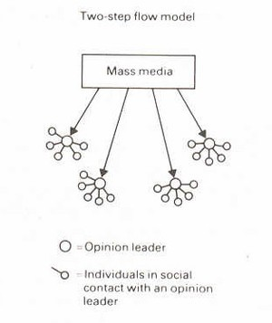

Slide 7
Minimal/ Limited Paradigm vs.
Mass Society Paradigm
Minimal/Limited
Indirect Diffusion over time
Audiences are active participants
Audiences are heterogenous
Mass Society Direct Immediate Audiences are
passive participants
Audiences are homogenous

Slide 8
Two-Step Flow Theory
Strengths
Focus on flow of influence
Audiences are active participants in the communication process and are seen as part of the society
Limitations
Flow of information
Flow of influence is intersecting
More complex
More than two steps in the flow of communication

Slide 9
3 Subsequent Studies
+
Elmira Study

Slide 10
Elmira Study (1948)
Bernard Berelson, Paul Lazarsfeld and William McPhee
Focus:
Social and Psychological Aspects of Political Behavior among Voters
Method Used:
Mailback Questionnaires, Telephone Interviews, and Personal Interviews

Slide 11
Rovere Study (1949)
Robert Merton (Sociologist)
Objective:
To solve the problem posed by the People's Choice
Focus:
Interpersonal influence and communications behavior
Limitation:
Little attention to interaction between leaders and the original informants

Slide 12
Decatur Study (1945-46)
Elihu Katz and Paul Lazarsfeld Decision-making in marketing, fashions,
movie-going and public affairs
Method Used:
Asked self-designating questions Accounted decisions and interviewed the
influentials

Slide 13
Decatur Study (1945-46)
Prior Focus
The relative importance of personal influence
The advisor-advisee dyad
Problem Encountered:
-Not all ‘snowball’ interviews could be completed

Slide 14
Decatur Study (1945-46)
Reasons for Goal Change
The urge to find out the opinion leader of an opinion leader
Opinion leaders are only influential in certain times and areas he is empowered
Not only in demographic terms, but also in terms of structure and values of the group

Slide 15
Decatur Study (1945-46)
Process of Diffusion
The spread of a product, process, or idea perceived as new, through communication channels, among the members of a social system over time.
Process:
Specific item
Diffusion over time
Through the social structure of an entire community

Slide 16
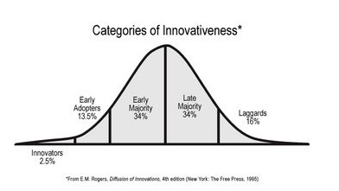

Slide 17
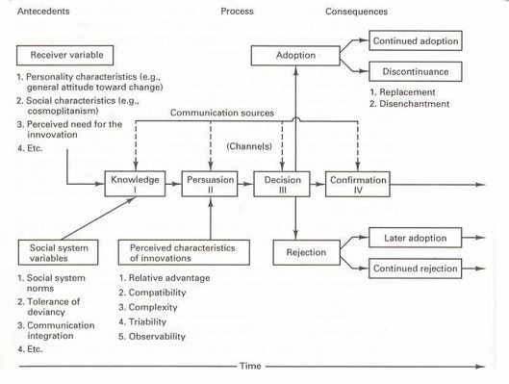

Slide 18
Drug Study (1955)
Herbert Menzel (Sociologist), Elihu Katz and James Coleman (Sociologist)
Objective: To determine the way doctors make decisions to adopt new drugs
Sociological and Psychological Framework
Prescription record and interview of decision-maker
Role of different influences on basis of decision-maker's own reconstruction, objective correlation, and sociometric data.

Slide 19
Drug Study (1955)
Method Used:
Sociometric Method(mapping networks of interpersonal relations)
Asked questions on background, attitudes, drug-use, exposure to sources of info and influence
Asked about 3 people who influenced them

Slide 20
Drug Study (1955)
2 Factors of True Diffusion Study: Attention to specific item (new drug) Record of diffusion over time
2 Central Factors of Integration in relation to Innovation:
Interpersonal Communication Social Support

Slide 21
3 Distinct Sets of Findings

Slide 22
Impact of Personal Influence
Personal Influence
Illustrate the process intervening between the media’s direct message and the audience’s reaction to that message
Mass Influence
Illustrate the process of transmitting a message to a wide-scale audience

Slide 23
Personal Influence vs. Mass Influence
Personal Influence
Non-purposive, flexible, trustworthy
The audience is...
Specific Discriminatory Limited
Mass Influence
Strengthens predispositions
The audience is...
Anonymous Non-discriminatory
Unlimited

Slide 24
Impact of Personal Influence
1. Personal Vs. Mass media Influence Elmira Study: Personal influence affected
voting decisions more than the mass media did.
Decatur Study: Personal influence figured both more frequently and more effectively than any of the mass media
Drug Study: Strong impact of personal relations even in the making of scientific decisions

Slide 25
Impact of Personal Influence
2. Homogeneity of Opinion in Primary Groups
Voting and Rovere Study: Homogeneity of groups influence potential deviants to conform
Drug Study: Doctors prescribe the new drug as their sociometric colleague does
virtually at the same time.

Slide 26
Impact of Personal Influence
3. Various Roles of the Media Voting Study: Media strengthens pre-
existing dispositions and decisions
Decatur Study: different media play different parts in the decision-making process
Drug Study:
2 Types of Media: Professional Media (legitimate) and Commercial Media (inform)

Slide 27
Impact of Personal Influence
3. Various Roles of the Media Voting Study: Media strengthens pre-
existing dispositions and decisions
Decatur Study: Different media play different parts in the decision-making process
Drug Study:
2 Types of Media: Professional Media (legitimate) and Commercial Media (inform)

Slide 28
Flow of Personal Influence
Three Certain Ways Identify Opinion Leaders
The Personification of Certain Values
“Who one is”
the opinion follower wants to be like the opinion leader
Competence
“What one knows”
An opinion follower prefers an opinion leader with the knowledge, familiarity, or expertise on the matter.

Slide 29
Flow of Personal Influence
3. Strategic Social Location ‘Whom one knows’
Divided into whom the opinion leader knows within a group and outside
Within the group
implies that the sphere of influence of the opinion leaders is within his/her group.
Outside the group
implies than an individual’s influence is not limited to his/her group, but also those who he/she knows outside his/her group

Slide 30
Opinion Leaders and the Mass Media
Opinion Leaders are more exposed to the mass media than those whom they influence.
Opinion Leaders are exposed to media appropriate to their sphere of influence.
Longer chains of person-to-person influence than the dyad may have to be traced back before any encounters with decisive influence by the mass media.

Slide 31
Conclusion
Interpersonal relations have a bigger role in influencing a decision than the mass media in that time. Despite their greater exposure to the media, opinion leaders are still primarily affected by other people.
3 Purposes of Interpersonal Relations
As Channels of Information
As Sources of Social Pressure As Sources of Social Support

Slide 32
Is Two-Step Flow Theory still applicable today?
“We find a striking concentration of attention on Twitter—roughly 50% of tweets consumed are generated by just 20K elite users—where the media produces the most information, but celebrities are the most followed.” --Yahoo! Research (2011)
Opinion Leaders: 20K Elite Users

Slide 33
References
Social Science Research Council. (n.d.). Elihu Katz: bibliography. The Media Research Hub. Retrieved, November 12, 2012, from: http://mediaresearchhub.ssrc.org/elihu-katz/person_view
Bellis, M. (2012).20th century timeline - the industrial thirties. About.com.
Retrieved, November 12, 2012, from: http://inventors.about.com/od/timelines/a/twentieth_4.htm
“What Events Happened in 1957.” (2004-2012). The People History: Where People Memories and History Join. Retrieved, November 12, 2012, from: http://www.thepeoplehistory.com/1957.html
“Two-step flow theory.” (2010). Communication Theories. Retrieved, November 12, 2012, from:
Wu, S., Hoffman, J.M., Mason, W.A., & Watts, D.J. (2011). Who says what to whom on Twitter. Yahoo! Research. Retrieved, November 12, 2012, from: http://research.yahoo.com/pub/3386
“Two step flow theory.” (n.d.). University of Twente. Retrieved, November 12, 2012, from:
“Media research of the 1940s” (2012). The Hebrew University of Jerusalem.
Retrieved, November 12, 2012, from: http://communication.mscc.huji.ac.il/upload/File/KatzCV.pdf

Slide 34
References
Elihu Katz. (1957). The two-step flow of communication: an up-to-date report on an hypothesis. Penn Libraries. November 12, 2012, from: http://repository.upenn.edu/cgi/viewcontent.cgi? article=1279&context=asc_papers&seiredir=1&referer=http%3A%2F
%2Fwww.google.com.ph%2Furl%3Fsa%3Dt%26rct%3Dj%26q%3Dpersonal
%2Binfluence%2Bkatz%2Breview%26source%3Dweb%26cd%3D7%26ved
%3D0CEoQFjAG%26url%3Dhttp%253A%252F%252Frepository.upenn.edu
%252Fcgi%252Fviewcontent.cgi%253Farticle%253D1279%2526context
%253Dasc_papers%26ei%3DLFuiUNesIc32mAXcgoHIBg%26usg
%3DAFQjCNG1pUznNyLidmBxXxc7oUG6rCID2w#search=%22personal
%20influence%20katz%20review%22
“Lazarsfeld, Paul F. (1901-1976).” (2012). Book Rags. Retrieved, November 12, 2012, from: http://www.bookrags.com/research/lazarsfeld-paul-f-1901-1976- eci-02/
Simonson, P. & Archer, Lauren. (n.d.). Classical Media Studies from the 1930s and ‘40s (A Sampling.). Media Research in the 1940s. Retrieved, November 12, 2012, from: http://www.outofthequestion.org/Media-Research-of-the- 1940s/Trends.aspx#Decatur

